Slide 1



Board Relations:
A View from the Other Side of the Table

Slide 2
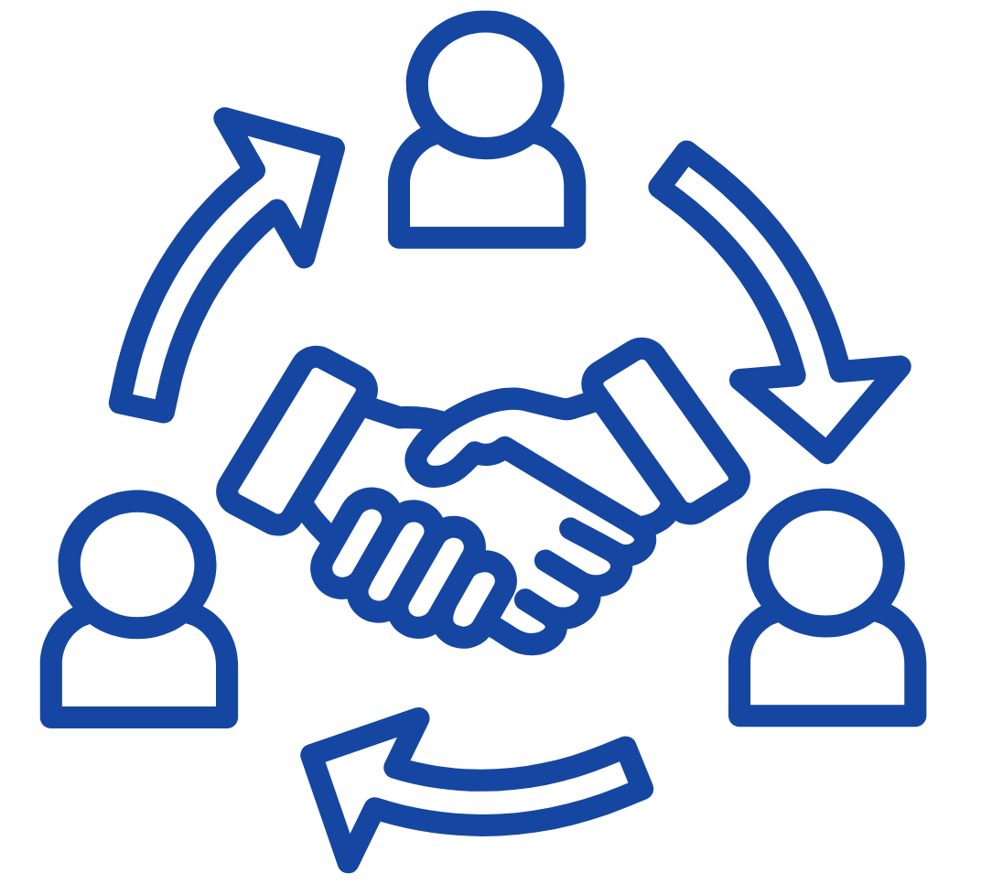
Board Relations

Slide 3
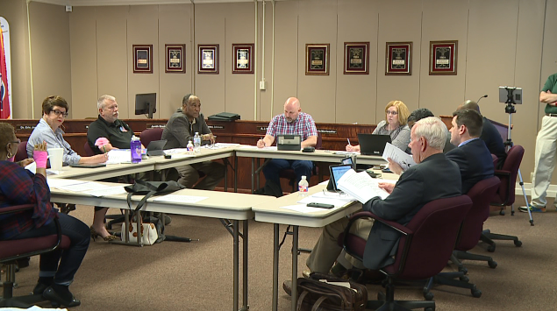
Board Relations
The best Superintendents ensure Board members are taught how to be effective as a board.

Slide 4

Board Relations
Building a strong relationship with your Board takes strategic planning on your part.

Slide 5

Board Relations
You must see the forest and the trees.

Slide 6

Board Relations
Any time you get a new Board member; you have a new Board.

Slide 7

Board Relations
Superintendents must take the lead in forming and maintaining a united school governance team.

Slide 8

Board Relations
One key to your success will be learning what the community expects of its
school Board members.

Slide 9
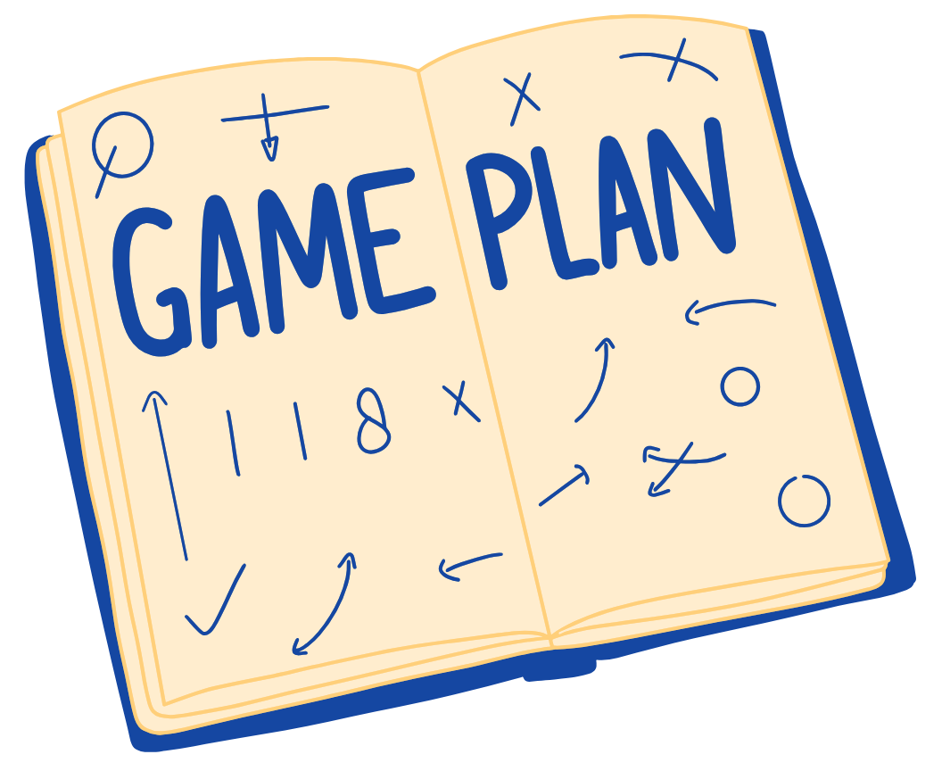
Board Relations
You should have a carefully crafted, agreed upon and well-executed plan for communications with your board.

Slide 10
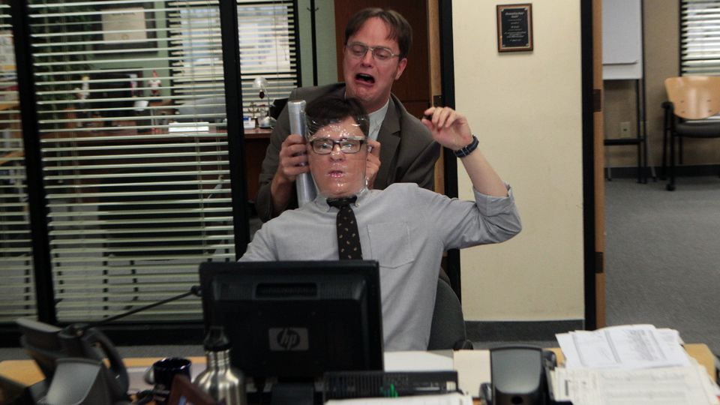
Board Relations
Most of the conflict between a Superintendent and the Board will arise from a misunderstanding of the respective roles and responsibilities.

Slide 11

Board Relations
The most important relationship you will have as Superintendent is the relationship with your Board.

Slide 12




Check out our podcast!
Follow us on social media!
#edcounsel
#trustedcounsel

Slide 13
Thank you!

